Slide 1
The gut microbiome, metabolic status, and obesity

Slide 2
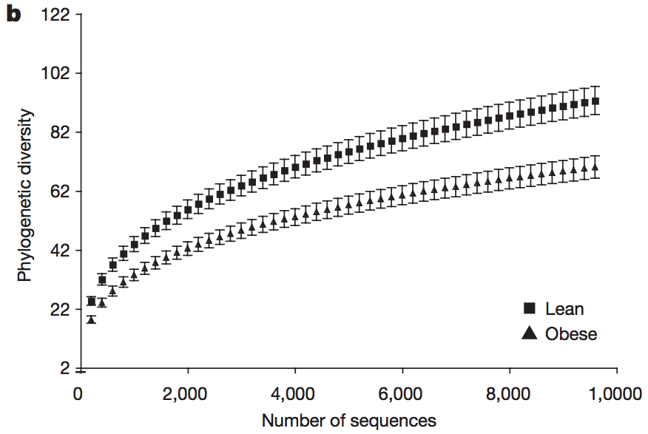
Deviations from a Core Microbiome
Via twin studies: microbiomes form a functional core
doi: 10.1038/nature07540
Notes:
Across all methods, obesity was associated with a significant decrease in the level of diversity

Slide 3
Deviations from a Core Microbiome
Metabolic profile-based clustering showed fore functional groups, included carbohydrate and amino acid metabolism among others
In obese patients, gut microbiome is enriched for phosphotransferase systems involved in carb processing
Broadly, leanness associated with enrichment of Bacteroidetes genes; obesity with enrichment of Actinobacteria and Firmicutes genes
doi: 10.1038/nature07540

Slide 4
Diet and the Microbiome
Diet has been shown to rapidly influence gut microbiota composition
High-fat diets see a decrease in Bacteroidetes and increases in Firmicutes and Proteobacteria
Microbiotal responses to dietary changes differ depending on host lean/obese status
(Fleissner, 2010; Hildebrandt, 2009; DiBaise, 2012)
Notes:
Specifically, easier for lean person to lose their Bacteroidetes than obese to lose Firmicutes

Slide 5
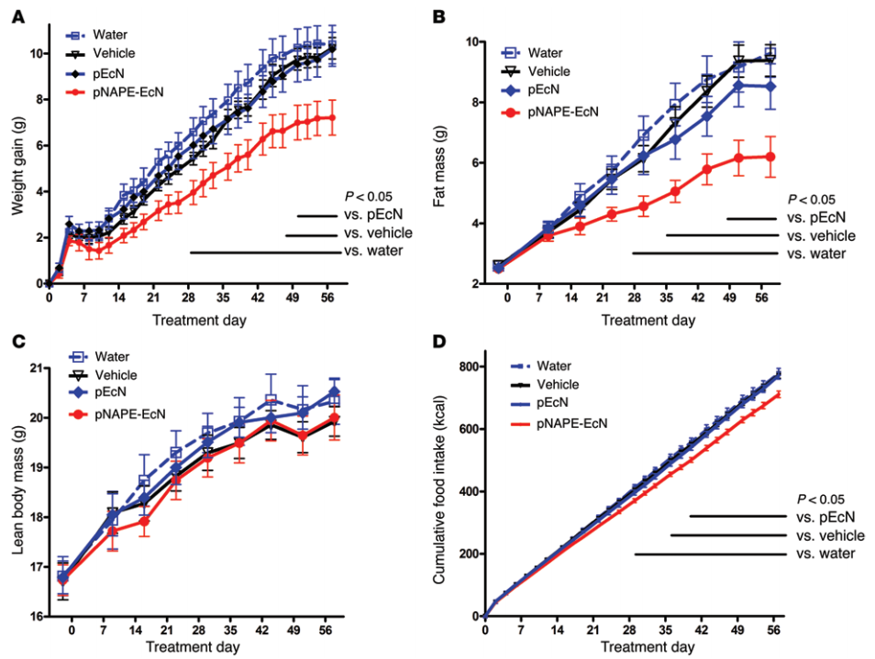
Treating Obesity by Microbiota Manipulation
doi: 10.1172/JCI72517
Notes:
For example, N-acylphosphatidylethanolamines (NAPEs) are precursors to the N-acylethanolamide (NAE) family of lipids, which are synthesized in the small intestine in response to feeding and reduce food intake and obesity
Here, we demonstrated that administration of engineered NAPE-expressing E. coli Nissle 1917 bacteria in drinking water for 8 weeks reduced the levels of obesity in mice fed a high-fat diet.

Slide 6
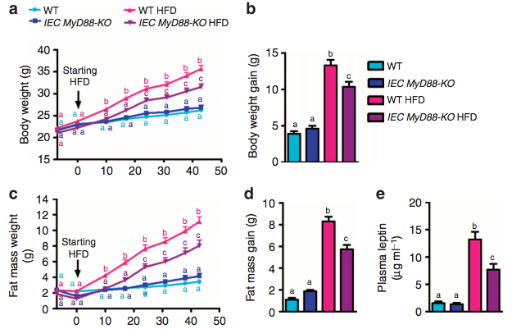
Treating Obesity by Microbiota Manipulation
doi: 10.1038/ncomms6648
Notes:
Here we report that inducible intestinal epithelial cell-specific deletion of MyD88 partially protects against diet-induced obesity, diabetes and inflammation.
Protection is transferred following gut microbiota transplantation to germ-free recipients
Targeting MyD88 after the onset of obesity reduces fat mass and inflammation.

Slide 7
References
Chen, Z., Guo, L., Zhang, Y., et al. (2014). Incorporation of therapeutically modified bacteria into gut microbiota inhibits obesity. Journal of Clinical Investigation, 124, 3391 – 3406.
DiBaise, J., Frank, D., & Mathur, R. (2012). Impact of the gut microbiota on the development of obesity: Current concepts. American Journal of Gastroenterology, 1, 22 –27.
Everard, A., Geurts, L., Caesar, R., et al. (2014). Intestinal epithelial MyD88 is a sensor switching host metabolism towards obesity according to nutritional status. Nature Communications, 5:5648.
Fleissner, C., Huebel, N., Abd El-Bary, M., et al. (2010). Absence of intestinal microbiota does not protect mice from diet-induced obesity. British Journal of Nutrition, 104, 919 –929.
Hildebrandt, M., Hoffmann, C., Sherrill-Mix, S., et al. (2009). High-fat diet determines the composition of the murine gut microbiome independently of obesity. Gastroenterology, 137, 1716 –1724.
Turnbaugh, R., Hamady, M., Yatsunenko, T., et al. (2009). A core gut microbiome in obese and lean twins. Nature, 457, 480 – 485.

